Slide 1


Cohort Analysis for Ironhack Payments
A presentation for IronHack Board of Directors.
September 2024

Slide 2












Project Overview
Timeline & Milestones
Analysis of the Frequency of the usage of IronHack cash advance Payments' services over time.
Determination of Payment Incident rate for each cohort
Determination of the revenue generated by each cohort over the months
Determination of Total fees by cohorts' overtime
Day 1
Project Kick off including gathering of requirements
Day 2
project team task distribution and alignment
Deliverable
Stakeholders
Result of a cohort analysis using Python, primarily leveraging the Pandas library for data manipulation and analysis.
The analysis should be presented in PowerPoint slide for informing the management of Ironhack.
The board of Directors
The finance team
The IT solutions team
The cohort recruitment team
Human Resource
Head of marketing
Day 3
Analysis of Service Usage Frequency.
Day 4
Determination of Payment Incident Rate.
Day 5
Revenue Generated by the Cohort and New Relevant Metric.
Assumptions
Project Team
Day 6
Development of presentation slides, final review and presentation
The higher the cash advance service usage, the higher total revenue.
The incident rate will increase from cohort to cohort
There is likely to be an effect of Covid 19 Pandemic in the result
Olagoke Somoye
Iciar Roldan
Giuseppe Nicolo
Budget
The project was executed with no budget.

Slide 3
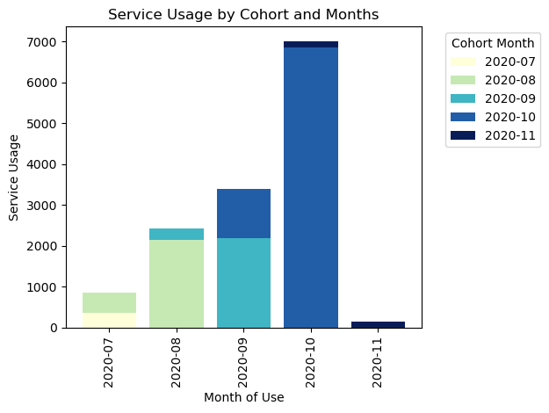

Usage Frequency of Cash Advance Payment
Key Take Aways
The IronHack cash advance payment service was used most by the October 2020 Cohort.
The cash advance payment services was least used by the November 2020 Cohort.
From the graph, we can also see that the usage of the cash advance payment service steadily grew cohort to cohort until the November 2020 Cohort, suggesting a possible change in user behavior or a specific event

Slide 4
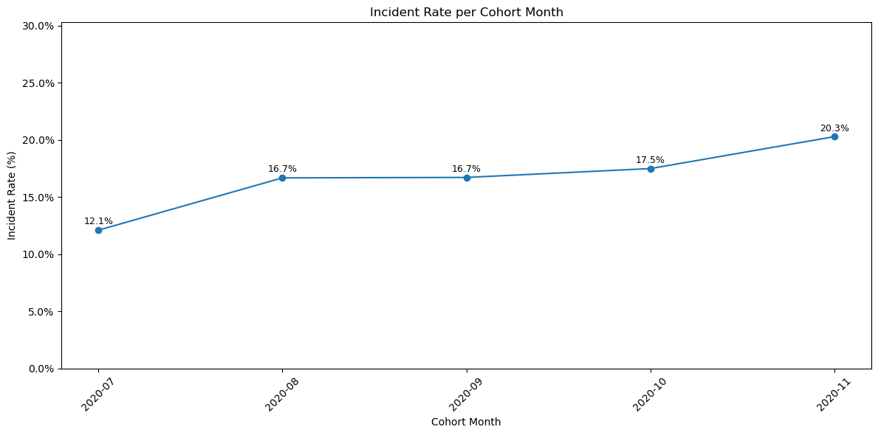
Determination of Payment Incident Rate
Key Take Aways
The incident rate increased sharply by 4.6% between the July and August 2020 cohort. Although considered minimal, this denotes a downward trend in payment incident.
The payment incident remained stable between the August and September cohort
However, an increasing trend was been observed in later months (October, November), suggesting the need to monitor any emerging problems.

Slide 5
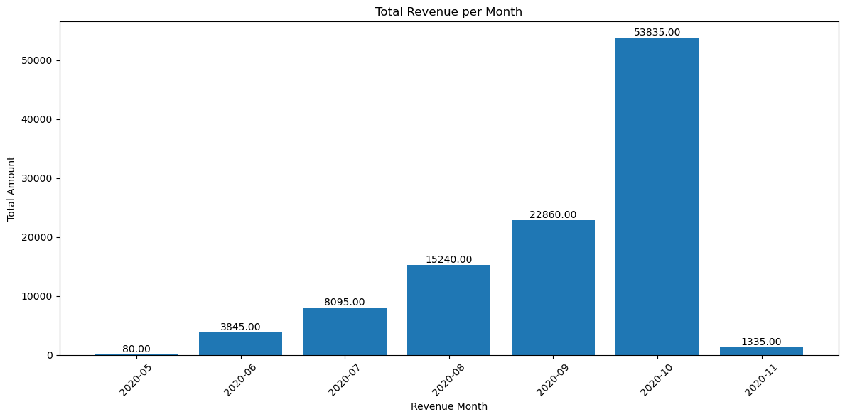
Revenue Generated by the Cohort
Key Take Aways
The total revenue steadily increased from month to month until November 2020 where a sharp decline was recorded.
This suggest a change in situation that needs to be further investigated perhaps this was the end of the Corona pandemic lockdown boom.

Slide 6
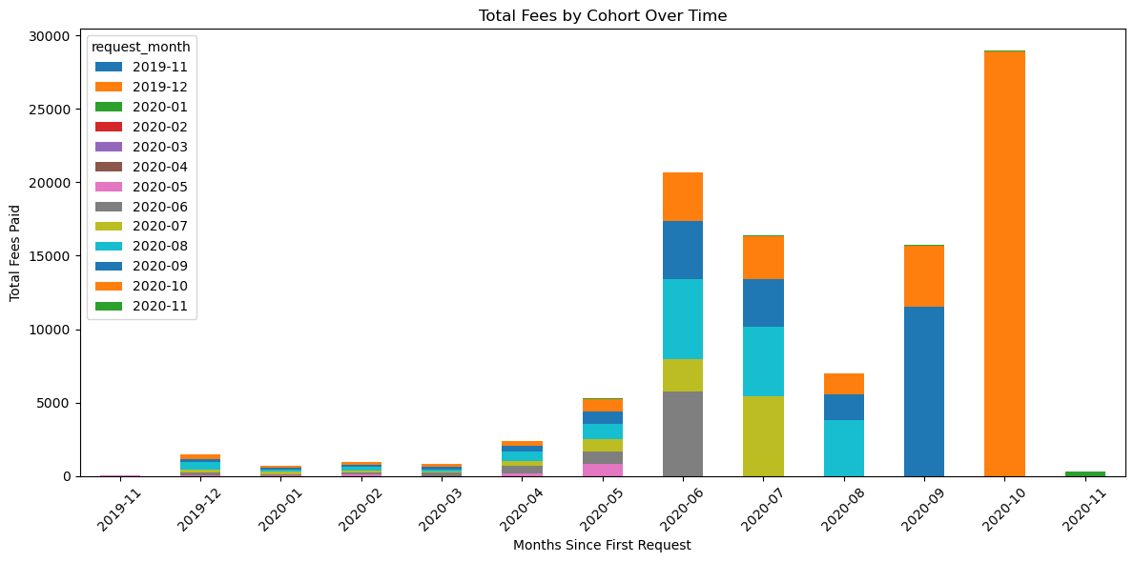
Determination of Total Payment over time
Key Take Aways
The October 2020 cohort contributed significantly to the total fees in the month of June, July, September and majorly in October 2020, this cohort stands out as one of the most valuable in terms of fee generation, especially compared to earlier cohorts.
Other cohorts, such as July 2020 (purple) and September 2020 (blue) also show strong contributions in later months.
The overall fee amount increased significantly in the later months compared to the earlier months

Slide 7
Overview
Recommendation
In general, we see from the analysis that the higher the cash advance service usage, the higher total revenue.
The November 2020 Cohort needs to be looked into in details in terms of the occurrence or service during this period as it recorded, the lowest usage of cash payment, lowest revenue, highest payment incident and lowest fees.
The data science team should be supported with some financial budget to further investigate the rationale for the decline in revenue for the November 2020 cohort.

Slide 8
Thank you for your attention!
For more information, please contact the Data science project team

